Slide 1

Group Bigfoot:
Final Chat App
Swamy Reddi (team lead)
Frank Feng (tech lead)
Nicole Du (doc lead)
Anand Gadsing (dev)
Daniel Kuo (dev)

Slide 2
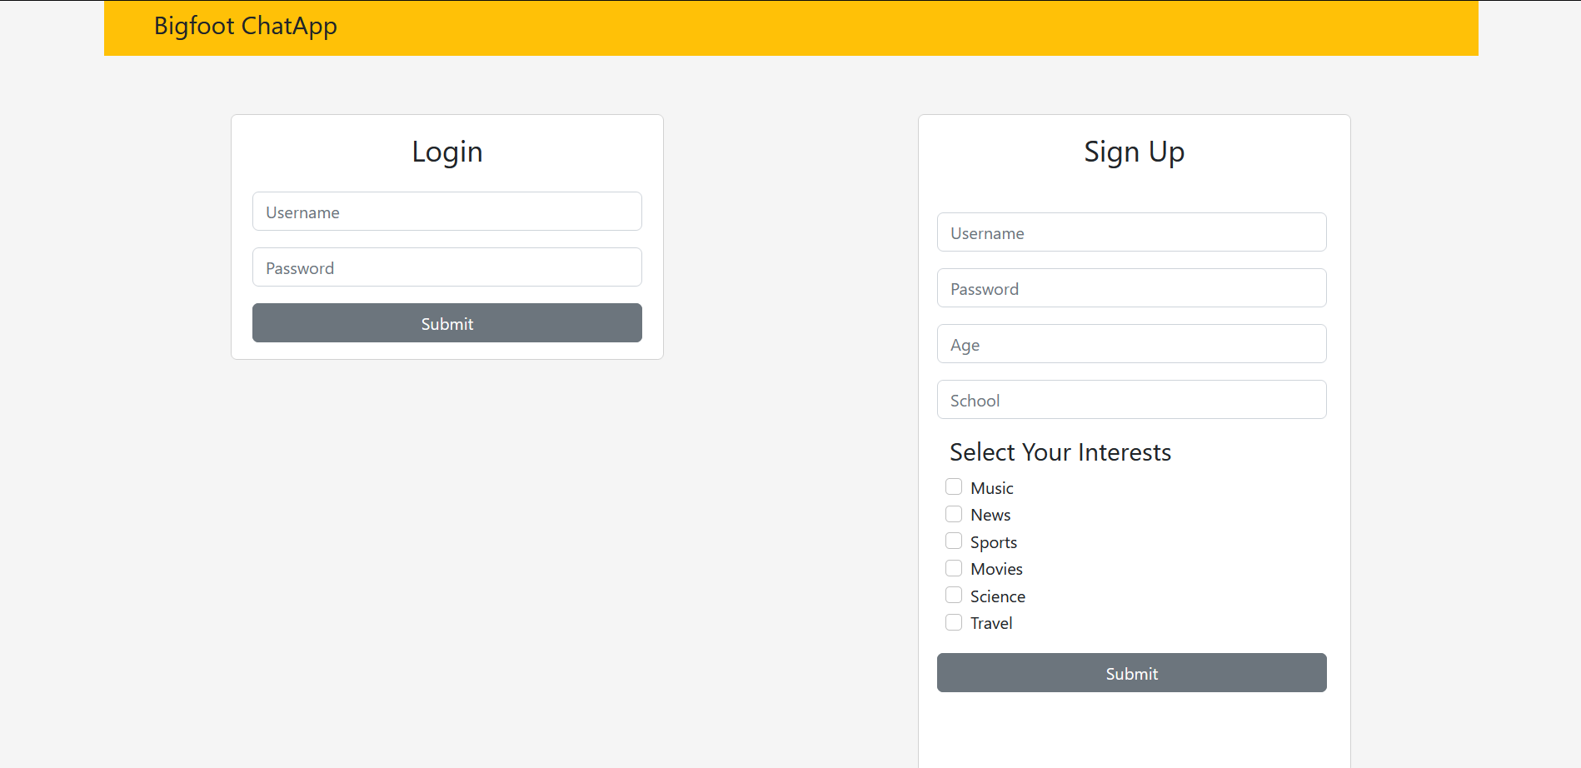
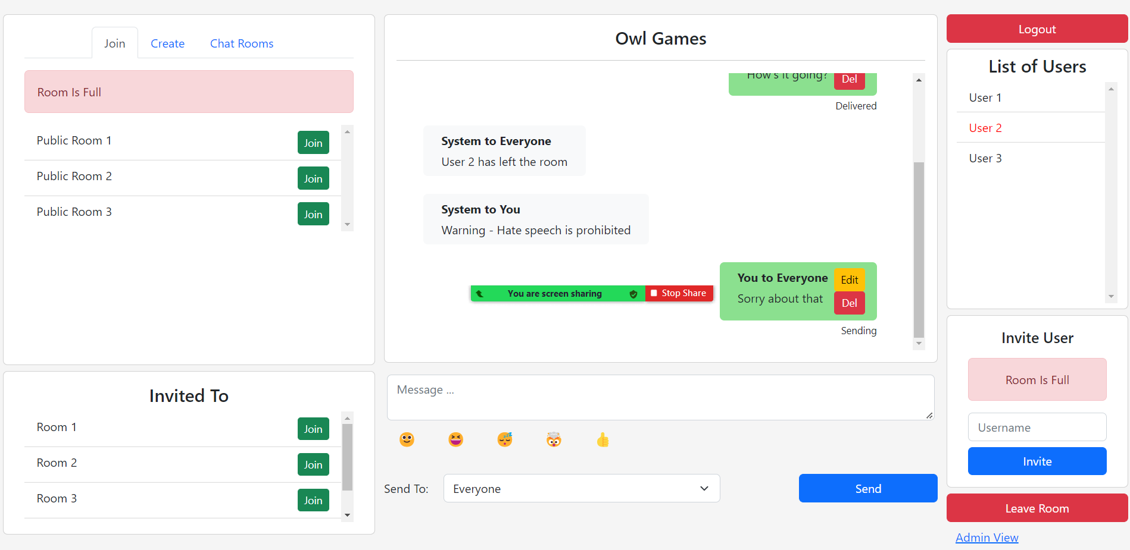
BigFoot’s Chat App
Intro:
Chatrooms with specific Interests
Public & Private Chatrooms
Safe & User-friendly
Ban Toxic Users
Up Next:
Overview of the Technical details
API End-points
Demo
LOGIN/SIGNUP
MAIN

Slide 3
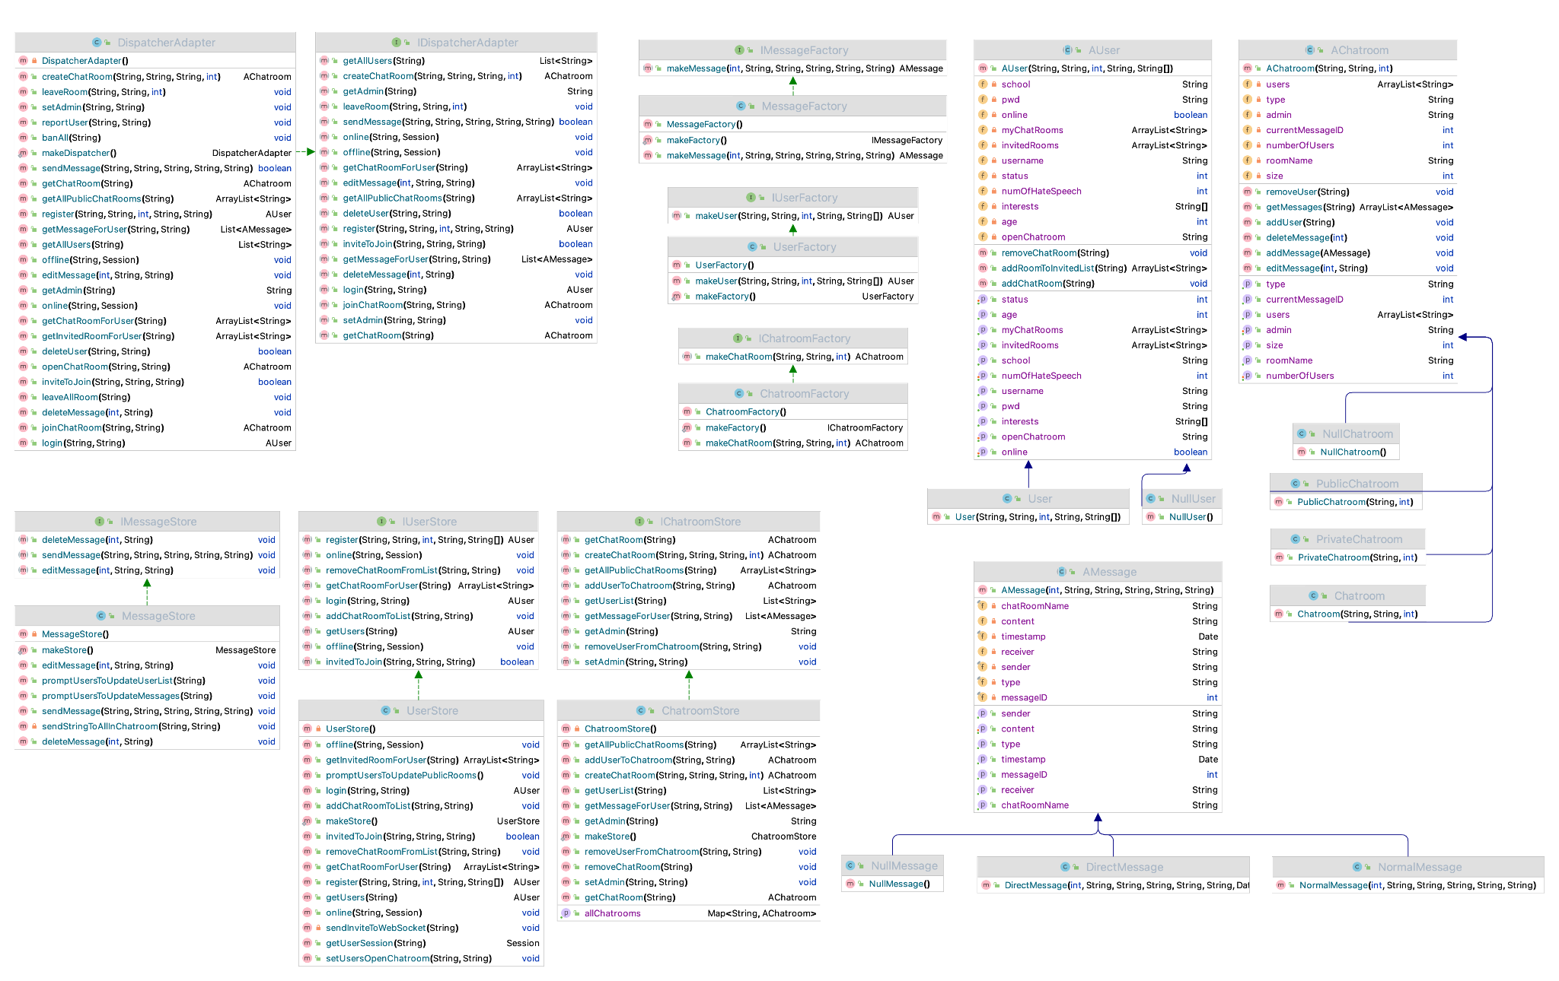
UML diagram

Slide 4
Before vs Now
Some design changes
Some api changes (abstract classes, interfaces, objects)

Slide 5
Structure Overview
Public Chatroom
Chatroom
Store
Chatroom
Objects
Private
Chatroom
Controller
Dispatch
Adapter
User Store
User Objects
Direct Message
Message Store
Message Objects
Normal Message

Slide 6
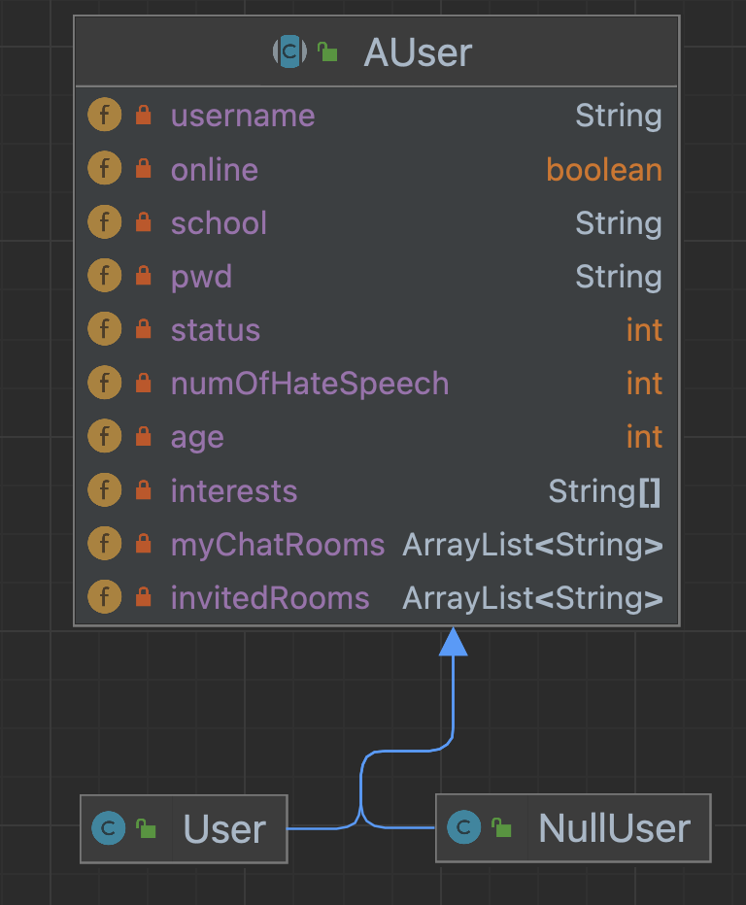
User Store
has username, password, relevant user information
list of joined chatrooms and invited chatrooms
Keep tracks of user status (online, offline, warned, banned)
AUser
Register (create user object and stored it in user store)
Login (check username and pwd, update user status to online – store session information in user store)
Use cases

Slide 7
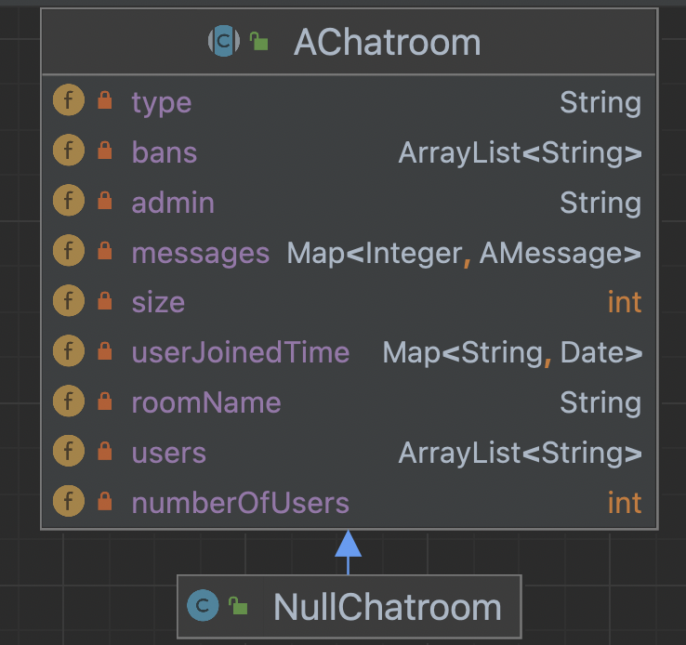
Chatroom Store
has room name, size, type (public, private), admin
Stores the messages in the chatroom
Contains list of users, banned users
AChatroom
join room
create room
leave ( voluntarily or banned)
Use cases

Slide 8
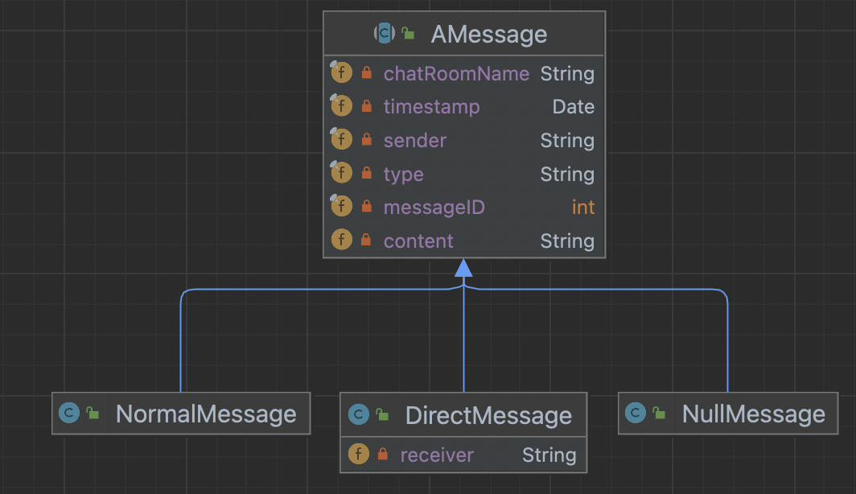
Message Store
has chatroom name, id, timestamp, sender, type (normal, direct)
normal message vs. direct message (have receiver)
AMessage
Edit, delete messages
Detects hate speech
Determine which user to send
Use cases

Slide 9
Design Pattern
MVC pattern
Singleton pattern
Null Object pattern
Factory pattern
Model
View
Controller
ChatroomStore
UserStore
MessageStore
NullChatroom
NullUser
NullMessage
ChatroomFactory
UserFactory
MessageFactory
Notes:
nicole
class
Model more resilient and efficient

Slide 10



API endpoints
User identification
POST /register register a new user with age, school, interests and password.
POST /login log in an existing user.
POST /logout log out the app.
Notes:
Nicole
I will divide it into 3 parts, first let’s look at user. For the identification, w have

Slide 11
Chatroom
Connection
API endpoints
Information retrieval
POST /chatroom/createChatroom
POST /chatroom/joinChatroom
POST /chatroom/connectToChatroom
POST /chatroom/leaveChatroom
POST /chatroom/leaveAllChatroom
POST /chatroom/inviteToChatroom
GET /chatroom/getChatroomList
GET /chatroom/userList
GET /chatroom/getAdmin
GET /chatroom/getInvitedRoomList
GET /chatroom/getPublicRoomList
Notes:
Nicole
Then look at chatroom
Post request
If I am the admin, we also have inviteToChatroom post endpoints to support the invite funcion

Slide 12
Message delivery
API endpoints
POST /chatroom/sendMessage send the message to either everyone or a specific user in the chat room
POST /chatroom/editMessage edit the message with a unique message id from a chat room
POST /chatroom/deleteMessage delete the message with a unique message id from a chat room
Notes:
Nicole
For the message part
Next anand will

Slide 13
GUI Demo
https://chatapp-api-team-bigfoot.herokuapp.com/

